Slide 1


Spring Framework
Exception, Swagger, Actuator, Thymeleaf

Slide 2


Content
1) Configuring Exception handler in Spring Boot app
2) Writing global exception handler
3) Introduction to Swagger APIs
4) Adding annotation to existing REST APIs
5) Testing REST APIs through Swagger URL
6) Configuring Actuator in spring boot app
7) Testing different endpoints provided by Actuator
8) Overriding existing Actuator endpoints
9) Building custom endpoint in Actuator
10) Introduction to Thymeleaf
11) Integrating Thymeleaf into Spring Boot app
12) Using Thymeleaf custom tags

Slide 3
Configuring Exception handler in Spring Boot app
Spring Boot is built on the top of the spring and contains all the features of spring.
And is becoming a favorite of developers these days because of its rapid production-ready environment which enables the developers to directly focus on the logic instead of struggling with the configuration and setup.
Spring Boot is a microservice-based framework and making a production-ready application in it takes very little time.
Exception Handling in Spring Boot helps to deal with errors and exceptions present in APIs so as to deliver a robust enterprise application.

Slide 4
Writing global exception handler
Using @ControllerAdvice for Global Exception Handler
@ExceptionHandler annotated method can only handle the exceptions thrown by that particular class.
However, if we want to handle any exception thrown throughout the application we can define a global exception handler class and annotate it with @ControllerAdvice.
This annotation helps to integrate multiple exception handlers into a single global unit.

Slide 5
Introduction to Swagger APIs
Swagger is an open source set of rules, specifications and tools for developing and describing RESTful APIs.
The Swagger framework allows developers to create interactive, machine and human-readable API documentation.
API specifications typically include information such as supported operations, parameters and outputs, authorization requirements, available endpoints and licenses needed.
Swagger can generate this information automatically from the source code by asking the API to return a documentation file from its annotations.
Swagger helps users build, document, test and consume RESTful web services. It can be used with both a top-down and bottom-up API development approach.
In the top-down, or design-first, method, Swagger can be used to design an API before any code is written. In the bottom-up, or code-first method, Swagger takes the code written for an API and generates the documentation.

Slide 6
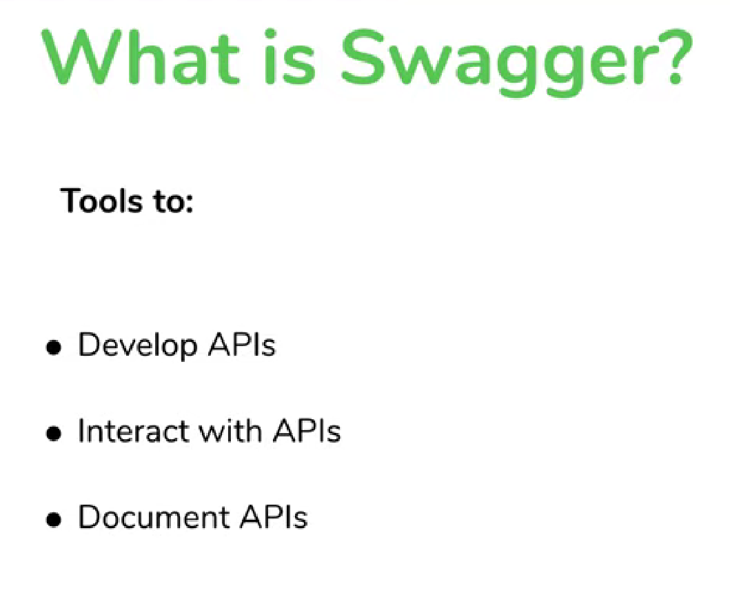

Slide 7
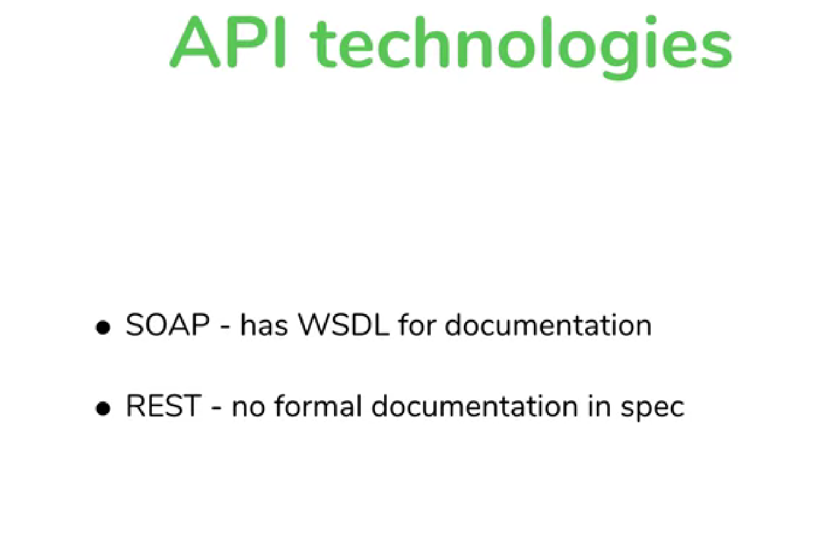
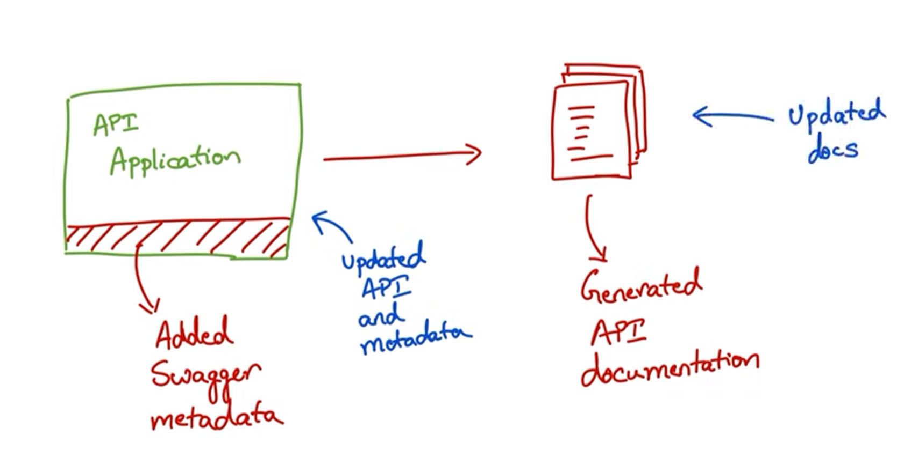

Slide 9
Components of Swagger
Swagger provides a variety of open source tools for APIs, including:
Swagger Editor- This enables developers to write documentation for, design and describe new APIs as well as edit existing ones. The browser-based editor visually renders OpenAPI specifications, handles errors and provides real-time feedback.
Swagger Codegen- This gives developers the ability to generate client library code and SDKs for different platforms
Swagger User Interface- This is a fully customizable tool that helps engineers generate documentation for various platforms. It can be hosted in any environment.
Swagger Inspector- This is a testing tool for API documentation. APIs can be easily validated without limits and results are automatically saved and accessed in the cloud.

Slide 10
Benefits of Swagger
It has a friendly user interface that maps out the blueprint for APIs.
Documentation is comprehensible for both developers and non-developers like clients or project managers.
Specifications are human and machine readable.
Generates interactive, easily testable documentation.
Supports the creation of API libraries in over 40 languages.
Format is acceptable in JSON and YAML to enable easier edits.
Helps automate API-related processes.

Slide 11
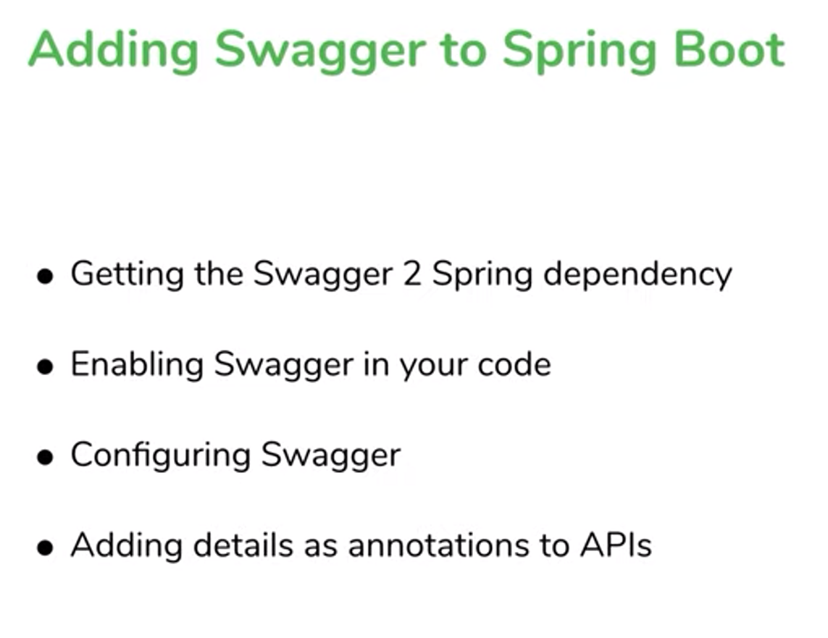
Adding annotation to existing REST APIs

Slide 12
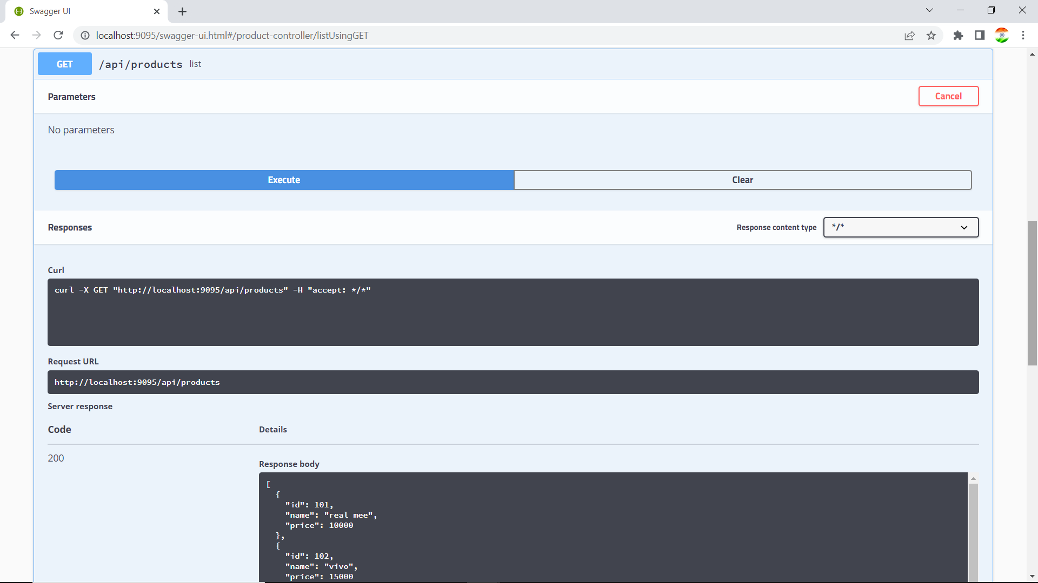
Testing REST APIs through Swagger URL

Slide 13
Spring Boot - Actuator
Spring boot’s module Actuator allows you to monitor and manage application usages in production environment, without coding and configuration for any of them. These monitoring and management information is exposed via REST like endpoint URLs.
Spring boot’s module Actuator allows you to monitor and manage application usages in production environment, without coding and configuration for any of them. These monitoring and management information is exposed via REST like endpoint URLs.
Spring Boot Actuator provides secured endpoints for monitoring and managing your Spring Boot application.
By default, all actuator endpoints are secured.
Spring boot’s module Actuator allows you to monitor and manage application usages in production environment, without coding and configuration for any of them.
These monitoring and management information is exposed via REST like endpoint URLs.

Slide 14
Configuring Actuator in spring boot app
Enabling Spring Boot Actuator
To enable Spring Boot actuator endpoints to your Spring Boot application, we need to add the Spring Boot Starter actuator dependency in our build configuration file.
<dependency>
<groupId>org.springframework.boot</groupId>
<artifactId>spring-boot-starter-actuator</artifactId>
</dependency>

Slide 15
Testing different endpoints provided by Actuator
https://docs.spring.io/spring-boot/docs/2.1.7.RELEASE/reference/html/production-ready-endpoints.html

Slide 16
Introduction to Thymeleaf
Thymeleaf is a server-side Java-based template engine for both web and standalone environments, capable of processing HTML, XML, JavaScript, CSS and even plain text.
It is more powerful than JPS and responsible for dynamic content rendering on UI. The engine allows a parallel work of the backend and frontend developers on the same view. It can directly access the java object and spring beans and bind them with UI.
And it is mostly used with spring MVC when we create any web application. So let’s start with an example to understand how Thymeleaf works with the Spring framework.

Slide 17
Introduction to Thymeleaf
The Thymeleaf is an open-source Java library that is licensed under the Apache License 2.0. It is a HTML5/XHTML/XML template engine. It is a server-side Java template engine for both web (servlet-based) and non-web (offline) environments. It is perfect for modern-day HTML5 JVM web development. It provides full integration with Spring Framework.
It applies a set of transformations to template files in order to display data or text produced by the application. It is appropriate for serving XHTML/HTML5 in web applications.
The goal of Thymeleaf is to provide a stylish and well-formed way of creating templates. It is based on XML tags and attributes. These XML tags define the execution of predefined logic on the DOM (Document Object Model) instead of explicitly writing that logic as code inside the template. It is a substitute for JSP.
The architecture of Thymeleaf allows the fast processing of templates that depends on the caching of parsed files. It uses the least possible amount of I/O operations during execution.

Slide 18
What kind of templates can the Thymeleaf process?
Thymeleaf can process six types of templates (also known as Template Mode) are as follows:
XML
Valid XML
XHTML
Valid XHTML
HTML5
Legacy HTML5

